Slide 1
Tokenization
CS XXX: Introduction to Large Language Models

Slide 2
Contents
Tokenization
Word Level Tokenization
Character Level Tokenization
Subword Tokenization
Tokenizer
Byte Pair Encoding
WordPiece
Unigram Language Model Tokenization

Slide 3
Tokenization
How do we represent an input text?
So far in this class… we chop it up into words
Input text: students opened their books
Input token IDs: 11 298 34 567

Slide 4
Word Level Tokenization
Word Based: Splitting a raw text into words
Out of vocabulary words result in a loss of information
Let’s | do | cool | malapromisms
250
861
10000
UNKNOWN

Slide 5
Word Level Tokenization
Not as simple as split on whitespace and punctuation…
Consider the example
“Dr. Smith's email is john.doe@example.com, and he said: 'Meet me at 5:00 p.m.!”
If you tokenize based on whitespace and punctuation, you might get:
["Dr", "Smith", "s", "email", "is", "john", "doe", "example", "com", "and", "he", "said", "Meet", "me", "at", "5", "00", "p", "m"]

Slide 6
Word Level Tokenization
Consider the example
“Dr. Smith's email is john.doe@example.com, and he said: 'Meet me at 5:00 p.m.!”
If you tokenize based on whitespace and punctuation, you might get:
["Dr", "Smith", "s", "email", "is", "john", "doe", "example", "com", "and", "he", "said", "Meet", "me", "at", "5", "00", "p", "m"]
Problems
Incorrect Tokenization of Possessives: "Smith's" becomes ["Smith", "s"], which loses the possessive meaning.
Email Address Splitting: "john.doe@example.com" is broken into ["john", "doe", "example", "com"], which isn't useful.
Time Format Issue: "5:00 p.m." turns into ["5", "00", "p", "m"], making it hard to understand as a time reference.
Quote Handling: Quotation marks are separated, making reconstructing the spoken sentence difficult.

Slide 7
Character Level Tokenization
Character Based: Splitting a raw text into characters
Out of vocabulary words result in a loss of information
L | e | t | ’ | s | d | o | c | o | o | l | m | a | l | o | p | r | o | m | i | s | m | s
12 | 5 | 20 | 40 | 19 | 4 | 15 | 3 | 15 | 15 | 12 | 13 | 1 | 12 | 15 | 16 | 18 | 15 | 16 | 9 | 19 | 13 | 19

Slide 8
Character Level Tokenization
Character Based: Splitting a raw text into characters
Out of vocabulary words result in a loss of information
While character tokenization reduces vocabulary size, it comes at the cost of increased sequence length, making it impractical for large-scale models unless handled efficiently
L | e | t | ’ | s | d | o | c | o | o | l | m | a | l | o | p | r | o | m | i | s | m | s
12 | 5 | 20 | 40 | 19 | 4 | 15 | 3 | 15 | 15 | 12 | 13 | 1 | 12 | 15 | 16 | 18 | 15 | 16 | 9 | 19 | 13 | 19

Slide 9
Sub-word Based Tokenization
Sub-word Based: Splitting a raw text into subwords
Middle ground between word and character based algorithms
Rare words should be decomposed into meaningful subwords
dogs
dog
s

Slide 10
Sub-word Based Tokenization
Most models obtaining state-of-the-art results in English today use some kind of subword-tokenization algorithm
Byte-Pair Encoding
WordPiece
Unigram

Slide 11
Tokenizer
At training time, the tokenizer processes the raw training corpus and learns a vocabulary by applying a tokenization algorithm (e.g., BPE, WordPiece, or Unigram).
At test (or inference) time, the pre-learned vocabulary is used to tokenize new, unseen text without modifying the vocabulary. The text is split into tokens according to the rules learned during training.

Slide 12
Byte Pair Encoding (BPE)
Simplest and commonly used algorithm for tokenization
Originally introduced as a text compression strategy
The algorithm depends on a pre-tokenizer that divides the training data into individual words.

Slide 13
Byte Pair Encoding (BPE)
The BPE algorithm has three steps:
Pre-tokenization
Base vocabulary
Pair Merging

Slide 14
Byte Pair Encoding (BPE)
Pre-tokenization:
Input: The algorithm starts with a corpus of text data.
Pre-tokenization: The corpus is pre-tokenized, usually by splitting the text into words. Pre-tokenization can involve breaking the text at spaces, punctuation, or using more complex rules.
After pre-tokenization, the algorithm creates a list of all unique words in the corpus, along with their frequency of occurrence.
Let us consider the toy corpus which consists of pre-tokenized text and its frequency.
Word | Frequency
cat | 10
bat | 5
bag | 12
tag | 4
cats | 5

Slide 15
Byte Pair Encoding (BPE)
Base Vocabulary:
The base vocabulary is initialized with all unique characters (or symbols) found in the list of unique words. For example, if the word "hello" is in the corpus, the symbols 'h', 'e', 'l', 'o' would be part of the initial vocabulary.
Each word in the corpus is then represented as a sequence of symbols from this base vocabulary. For instance, "hello" would be represented as ['h', 'e', ‘l', 'l', 'o’].
Form the base vocabulary by taking all the characters that occur in the training corpus.
Base vocabulary: a, b, c, g, s, t
Word | Frequency
cat | 10
bat | 5
bag | 12
tag | 4
cats | 5

Slide 16
Byte Pair Encoding (BPE)
Pair Merging:
Bigram Counts: The algorithm counts the frequency of adjacent symbol pairs (bigrams) in the list of unique words. For example, in "hello", the bigrams would be ('h', 'e'), ('e', 'l'), ('l', 'l'), ('l', 'o').
Merging: The most frequent bigram is then merged into a new symbol, and the words in the corpus are updated to reflect this merge. For example, if ('l', 'l') is the most frequent bigram, it is merged into a new symbol, say 'll', and "hello" would be updated to ['h', 'e', 'll', 'o’].
This process continues iteratively until the desired vocabulary size is reached.

Slide 17
Byte Pair Encoding (BPE)
Pair Merging:
At each stage of the training, the BPE algorithm identifies the most frequent pair of existing tokens. This most frequent pair is then merged.
We split each word into its constituent characters (tokens) as per the base vocabulary.
Vocabulary = [a, b, c, g, s, t]
Split into characters Unique Bigrams
Word | Frequency
c,a,t | 10
b,a,t | 5
b,a,g | 12
t,a,g | 4
c,a,t,s | 5
Tokens | Frequency
ca | 15
at | 20
ba | 17
ag | 16
ts | 5

Slide 18
Byte Pair Encoding (BPE)
Pair Merging:
Select the most frequent pair (a, t) and merge them into a single symbol. Add this newly created symbol to the vocabulary.
Vocabulary = [a, b, c, g, s, t, at]
The first merge rule learned by the tokenizer is a, t → at and the pair should be merged in all the words of the corpus.
Word | Frequency
c,at | 10
b,at | 5
b,a,g | 12
t,a,g | 4
c,at,s | 5
Tokens | Frequency
ag | 16
cat | 15
ba | 12
bat | 5
ats | 5

Slide 19
Byte Pair Encoding (BPE)
Pair Merging:
The most frequent pair at this stage is (a, g).
The second merge rule learned is a, g → ag. Adding that to the vocabulary and merging all existing occurrences leads us to:
Vocabulary = [a, b, c, g, s, t, at, ag]
Tokens | Frequency
c,at | 10
b,at | 5
b,ag | 12
t,ag | 4
c,at,s | 5

Slide 20
Byte Pair Encoding (BPE)
Pair Merging:
Now the most frequent pair is (c, at), so we learn the merge rule c, at → cat.
After three merges, the vocabulary and corpus are as follows:
Vocabulary = [a, b, c, g, s, t, at, ag, cat]
We keep iterating through these steps until the vocabulary reaches the desired size.
Tokens | Frequency
cat | 10
b,at | 5
b,ag | 12
t,ag | 4
cat,s | 5

Slide 21
Byte Pair Encoding (BPE)
On test or inference, we run each merge learned from the training data in a greedy manner, successively in the order we learned them, i.e.
a, t → at
a, g → ag
c, at → cat
For example, the word “bag” would be tokenized as follows:
We begin by splitting the word into its constituent characters: bags → b, a, g, s.
We go through the merge rules until we find one we can apply. Observe the second rule can be applied and merge the characters a and g: bags → b, ag, s
When we have exhausted all the merge rules, the tokenization process is complete.
bags → b, ag, s

Slide 22
Byte Pair Encoding (BPE)
Handling Unknown Words
If the word being tokenized includes a character that was not present in the training corpus, that character will be converted to the unknown token (<UNK>).
mat → [UNK], at
To avoid <UNK>, the base vocabulary must include every possible character or symbol. This can be extensive, specially since there are about ~149K Unicode symbols.

Slide 23
WordPiece Tokenization
The WordPiece algorithm, like Byte-Pair Encoding (BPE), is used for subword tokenization, but it employs a different approach to determine which symbol pairs to merge.
Unlike BPE, merges in WordPiece algorithm are determined by likely-hood, and not frequency.

Slide 24
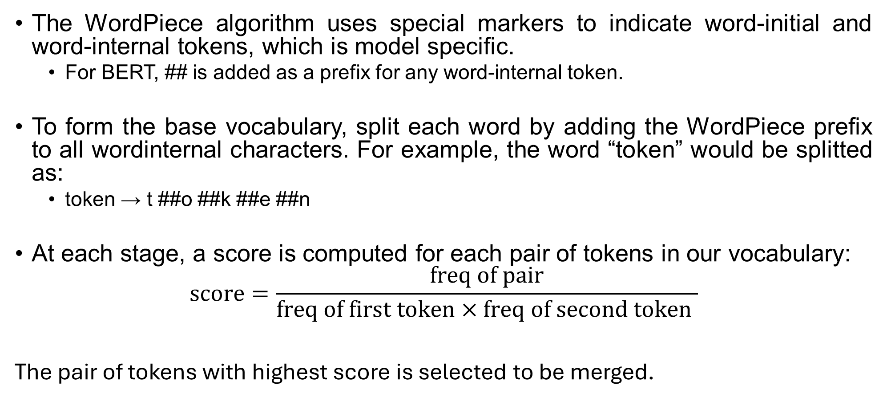
WordPiece Tokenization
The WordPiece algorithm uses special markers to indicate word-initial and word-internal tokens, which is model specific.
For BERT, ## is added as a prefix for any word-internal token.
To form the base vocabulary, split each word by adding the WordPiece prefix to all wordinternal characters. For example, the word “token” would be splitted as:
token → t ##o ##k ##e ##n
At each stage, a score is computed for each pair of tokens in our vocabulary:
$$\text{score}=\frac{\text{freq} \text{of} \text{pair}}{\text{freq} \text{of} \text{first} \text{token}×\text{freq} \text{of} \text{second} \text{token} }$$
The pair of tokens with highest score is selected to be merged.

Slide 25
WordPiece Tokenization
Like BPE, the WordPiece Algorithm has the following steps:
Pre-tokenziation
Base Vocabulary
Pair Merging

Slide 26
WordPiece Tokenization
Let us take a look at the toy corpus, which we will use to train the WordPiece tokenizer.
Word | Frequency
Sunflower | 1
Sun | 2
flower | 1
flow | 1
flowers | 1
flowing | 2
flows | 2
flowed | 1

Slide 27
WordPiece Tokenization
Pre-tokenization
Word | Frequency
s, ##u, ##n, ##f, ##l, ##o, ##w, ##e, ##r 1 | 1
s, ##u, ##n | 2
f, ##l, ##o, ##w, ##e, ##r | 1
f, ##l, ##o, ##w | 1
f, ##l, ##o, ##w, ##e, ##r, ##s | 1
f, ##l, ##o, ##w, ##i, ##n, ##g | 2
f, ##l, ##o, ##w, ##s | 2
f, ##l, ##o, ##w, ##e, ##d | 1

Slide 28
WordPiece Tokenization
Base Vocabulary
Vocabulary = [##d, ##e, ##f, ##g, ##i, ##l, ##n, ##o, ##r, ##s, ##u, ##w, f, s]

Slide 29

WordPiece Tokenization
Pair Merging
“s” occurs 3 times (note that s and ##s are different)
##u occurs 3 times
su occurs 3 times
$${\text{score}}_{s,\#\#u}=\frac{3}{3×3}=0.33$$
Word | Frequency
s, ##u, ##n, ##f, ##l, ##o, ##w, ##e, ##r | 1
s, ##u, ##n | 2
f, ##l, ##o, ##w, ##e, ##r | 1
f, ##l, ##o, ##w | 1
f, ##l, ##o, ##w, ##e, ##r, ##s | 1
f, ##l, ##o, ##w, ##i, ##n, ##g | 2
f, ##l, ##o, ##w, ##s | 2
f, ##l, ##o, ##w, ##e, ##d | 1
Word | Frequency
s, ##u, ##n, ##f, ##l, ##o, ##w, ##e, ##r | 1
s, ##u, ##n | 2
f, ##l, ##o, ##w, ##e, ##r | 1
f, ##l, ##o, ##w | 1
f, ##l, ##o, ##w, ##e, ##r, ##s | 1
f, ##l, ##o, ##w, ##i, ##n, ##g | 2
f, ##l, ##o, ##w, ##s | 2
f, ##l, ##o, ##w, ##e, ##d | 1

Slide 30
WordPiece Tokenization
Pair Merging
• We will calculate the score for each pair.
Select the pair with highest score to be merged - s, ##u
s + ##u → su
Token Pair | Frequency
s, ##u | 0.33
##u, ##n | 0.2
##n, ##f | 0.2
##f, ##l | 0.11
##l, ##o | 0.11
. . . | ...
##e, ##r | 0.25
##e, ##d | 0.25

Slide 31
WordPiece Tokenization
Pair Merging
• We add the merged pair to the vocabulary and apply the merge to the words in the corpus.
Vocabulary = [##d, ##e, ##f, ##g, ##i, ##l, ##n, ##o, ##r, ##s, ##u, ##w, f, s, su]
Word | Frequency
su, ##n, ##f, ##l, ##o, ##w, ##e, ##r | 1
su, ##n | 2
f, ##l, ##o, ##w, ##e, ##r | 1
f, ##l, ##o, ##w | 1
f, ##l, ##o, ##w, ##e, ##r, ##s | 1
f, ##l, ##o, ##w, ##i, ##n, ##g | 2
f, ##l, ##o, ##w, ##s | 2
f, ##l, ##o, ##w, ##e, ##d | 1

Slide 32
WordPiece Tokenization
Pair Merging
• We continue this process for a few more steps.
Compute score for all pair of tokens.
The best score is shared by ##e, ##r and ##e, ##d. Let’s say, we select ##e, ##r as the best pair and merge them.
##e + ##r → ##er
Token Pair | Frequency
su, ##n | 0.2
##n, ##f | 0.2
##f, ##l | 0.11
##e, ##r | 0.25
. . . | ...
##e, ##d | 0.25

Slide 33
WordPiece Tokenization
Pair Merging
• At this point of the training algorithm, we have
Vocabulary = [##d, ##e, ##f, ##g, ##i, ##l, ##n, ##o, ##r, ##s, ##u, ##w, f, s, su, ##er]
Word | Frequency
su, ##n, ##f, ##l, ##o, ##w, ##er | 1
su, ##n | 2
f, ##l, ##o, ##w, ##er | 1
f, ##l, ##o, ##w | 1
f, ##l, ##o, ##w, ##er, ##s | 1
f, ##l, ##o, ##w, ##i, ##n, ##g | 2
f, ##l, ##o, ##w, ##s | 2
f, ##l, ##o, ##w, ##e, ##d | 1

Slide 34
WordPiece Tokenization
Pair Merging
• Next ##e, ##d has the highest score and is merged
##e + ##d → ##ed
Vocabulary = [##d, ##e, ##f, ##g, ##i, ##l, ##n, ##o, ##r, ##s, ##u, ##w, f, s, su, ##er, ##ed]
We continue this process until we reach the desired vocabulary size.
Token Pair | Frequency
su, ##n | 0.2
##n, ##f | 0.2
##f, ##l | 0.11
. . . | ...
##e, ##d | 1

Slide 35
WordPiece Tokenization
On test or inference, Tokenization in WordPiece differs from BPE.
In WordPiece retains only the final vocabulary and does not store the merge rules learned during the process.
To tokenize a word, WordPiece identifies the longest subword available in the vocabulary and then performs the split based on that subword.

Slide 36
WordPiece Tokenization
Vocabulary = [##d, ##e, ##f, ##g, ##i, ##l, ##n, ##o, ##r, ##s, ##u, ##w, f, s, su, ##er, ##ed]
For example, let’s take the word – fused.
If we use the vocabulary learned in the example, for the word "fused" the longest subword starting from the beginning that is present in the vocabulary is "f", so we split there and get "f", "##used".
For "##used," the longest subword in the vocabulary is "##u," so you split into ["##u", "##sed"].
Next, for "##sed," the longest subword in the vocabulary is "##s," so you split into ["##s", "##ed"].
Finally, "##ed" is a complete token in the vocabulary, so no further splitting is needed.
So the full breakdown for "fused" would be:
["f", "##u", "##s", "##ed"]

Slide 37
WordPiece Tokenization
Handling Unknown Words
Unlike BPE, If it’s not possible to find a subword in the vocabulary, the whole word is tokenized as unknown
funny => “f”, “##u”, and “##n” present but “##y” is absent. funny will be replaced by <UNK>

Slide 38
Unigram Language Model Tokenization
A single word or sentence can be divided into different subwords even when using the same vocabulary.
For example: run can be divided into r,u,n r,un ru,n
Unlike additive techniques like BPE, Unigram Language Model tokenization introduces multiple subword candidates during training and prunes less probable tokens from an initially large vocabulary.

Slide 39
Unigram Language Model Tokenization
A single word or sentence can be divided into different subwords even when using the same vocabulary.
For example: run can be divided into r,u,n r,un ru,n
Unlike additive techniques like BPE, Unigram Language Model tokenization introduces multiple subword candidates during training and prunes less probable tokens from an initially large vocabulary.

Slide 40
Unigram Language Model Tokenization
The Unigram Language Model tokenization algorithm can be divided into 4 steps
Initializing the Base Vocabulary
Log-Likelihood Loss Computation
Finding Candidates for Removal
Progressive Vocabulary Pruning

Slide 41
Unigram Language Model Tokenization
Initializing the Base Vocabulary
There are various methods for creating the seed vocabulary. A common approach is to include all characters and the most frequent substrings found in the corpus.
Let us consider the following toy corpus.
We will include all possible strict substrings in the initial vocabulary.
Vocabulary = [r, u, n, ru, un, b, g, bu, ug, f, fu, s, su]
Word | Frequency
run | 3
bug | 5
fun | 13
sun | 10

Slide 42
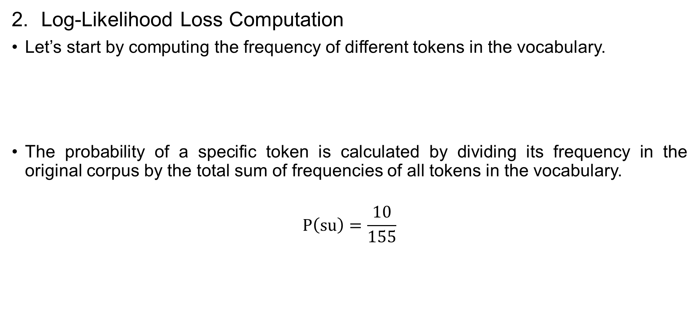
Unigram Language Model Tokenization
Log-Likelihood Loss Computation
Let’s start by computing the frequency of different tokens in the vocabulary.
The probability of a specific token is calculated by dividing its frequency in the original corpus by the total sum of frequencies of all tokens in the vocabulary.
$$P\left(\text{su}\right)=\frac{10}{155}$$
Token | r | u | n | ru | un | b | g | bu | ug | f | fu | s | su
Freq | 3 | 31 | 26 | 3 | 26 | 5 | 5 | 5 | 5 | 13 | 13 | 10 | 10
Token | r | u | n | ru | un | b | g | bu | ug | f | fu | s | su
Freq | 0.0194 | 0.2 | 0.1677 | 0.0194 | 0.1677 | 0.0323 | 0.0323 | 0.0323 | 0.0323 | 0.0839 | 0.0839 | 0.0645 | 0.0645

Slide 43
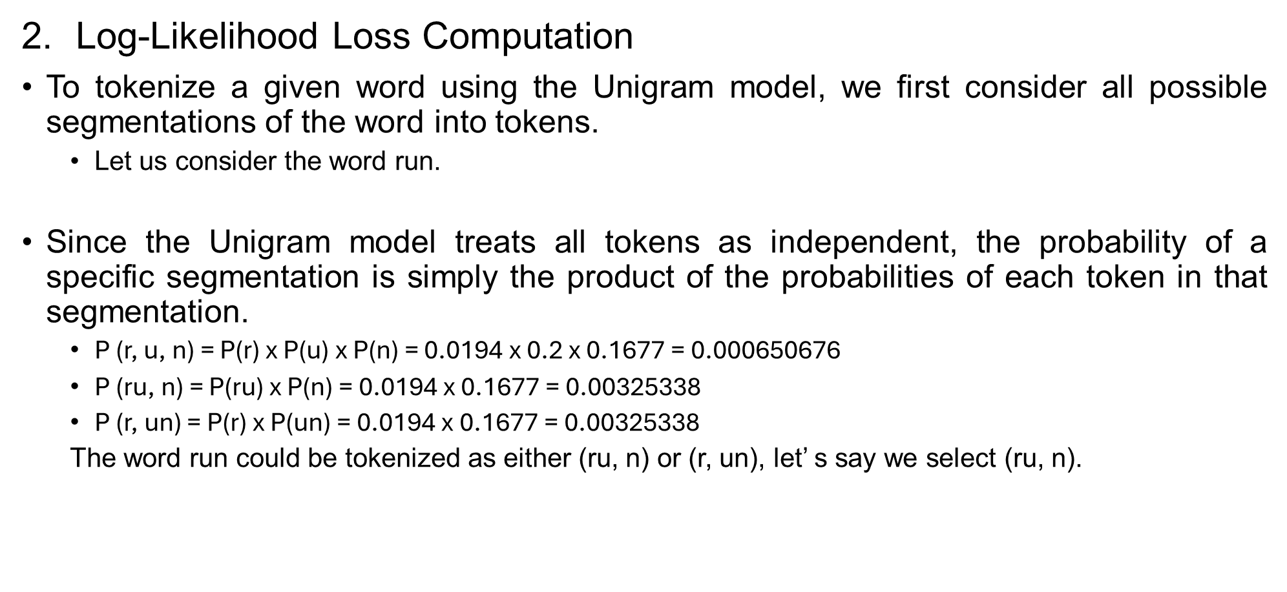
Unigram Language Model Tokenization
Log-Likelihood Loss Computation
To tokenize a given word using the Unigram model, we first consider all possible segmentations of the word into tokens.
Let us consider the word run.
Since the Unigram model treats all tokens as independent, the probability of a specific segmentation is simply the product of the probabilities of each token in that segmentation.
P (r, u, n) = P(r) x P(u) x P(n) = 0.0194 x 0.2 x 0.1677 = 0.000650676
$\text{P}\text{ (}\text{ru}\text{, }\text{n}\text{) = }\text{P}\text{(}\text{ru}\text{) }\text{x} \text{P}\text{(}\text{n}\text{) = 0.0194 }\text{x}\text{ 0.1677 = 0.00325338}$
$\text{P}\text{ (}\text{r}\text{, }\text{un}\text{) = }\text{P}\text{(}\text{r}\text{) }\text{x} \text{P}\text{(}\text{un}\text{) = 0.0194 }\text{x}\text{ 0.1677 = 0.00325338}$
The word run could be tokenized as either (ru, n) or (r, un), let’ s say we select (ru, n).

Slide 44
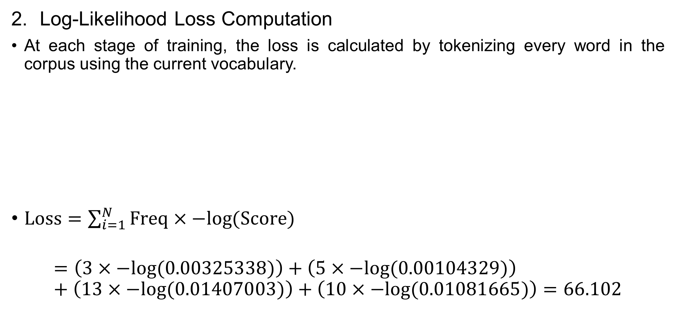
Unigram Language Model Tokenization
Log-Likelihood Loss Computation
At each stage of training, the loss is calculated by tokenizing every word in the corpus using the current vocabulary.
$\text{Loss}=\sum_{i=1}^{N}{\text{Freq}×−log{(\text{Score})}}$
$$=\left(3×−log⁡(0.00325338)\right)+\left(5×−log⁡(0.00104329)\right)+\left(13×−log⁡(0.01407003)\right)+\left(10×−log⁡(0.01081665)\right)=66.102$$
Word | Freq | Split | Score
Run | 3 | ru, n | 0.00325338
Bug | 5 | bu, g | 0.00104329
Fun | 13 | fu, n | 0.01407003
Sun | 10 | su, n | 0.01081665

Slide 45
Unigram Language Model Tokenization
Finding Candidates For Removal
Our goal is to reduce the vocabulary size.
To determine which token to remove, we will calculate the associated loss for each token in the vocabulary that is not an elementary token, then compare these losses.
For example, let’s remove the token un.
• Possible segmentations for the word run: (r, u, n); (ru, n); (r, un)
Token | r | u | n | ru | b | g | bu | ug | f | fu | s | su
Freq | 0.0194 | 0.2 | 0.1677 | 0.0194 | 0.0323 | 0.0323 | 0.0323 | 0.0323 | 0.0839 | 0.0839 | 0.0645 | 0.0645

Slide 46
Unigram Language Model Tokenization
Finding Candidates For Removal
Our goal is to reduce the vocabulary size.
To determine which token to remove, we will calculate the associated loss for each token in the vocabulary that is not an elementary token, then compare these losses.
For example, let’s remove the token un.
Possible segmentations for the word run: (r, u, n); (ru, n); (r, un)
P (r, u, n) = P(r) x P(u) x P(n) = 0.0194 x 0.2 x 0.1677 = 0.000650676
P (ru, n) = P(ru) x P(n) = 0.0194 x 0.1677 = 0.00325338
Token | r | u | n | ru | b | g | bu | ug | f | fu | s | su
Freq | 0.0194 | 0.2 | 0.1677 | 0.0194 | 0.0323 | 0.0323 | 0.0323 | 0.0323 | 0.0839 | 0.0839 | 0.0645 | 0.0645

Slide 47

Unigram Language Model Tokenization
Finding Candidates For Removal
Loss (after removal of token un)
$$=\left(3×−log⁡(0.00325338)\right)+\left(5×−log⁡(0.00104329)\right)+\left(13×−log⁡(0.01407003)\right)+\left(10×−log⁡(0.01081665)\right)=66.102$$
Word | Freq | Split | Score
Run | 3 | ru, n | 0.00325338
Bug | 5 | bu, g | 0.00104329
Fun | 13 | fu, n | 0.01407003
Sun | 10 | su, n | 0.01081665

Slide 48
Unigram Language Model Tokenization
Finding Candidates For Removal
For the first iteration, removing any token would not affect the loss.
Randomly, we select the token un and remove it from the vocabulary. We proceed with the second iteration.
Token removed from vocabulary | Loss
ru | 66.102
un | 66.102
bu | 66.102
ug | 66.102
fu | 66.102
su | 66.102

Slide 49
Unigram Language Model Tokenization
Vocabulary Pruning
We recompute the probabilities after removal of the token un.
Randomly, we select the token un and remove it from the vocabulary. We proceed with the second iteration.
Token removed from vocabulary | Loss
ru | 66.102
un | 66.102
bu | 66.102
ug | 66.102
fu | 66.102
su | 66.102

Slide 50
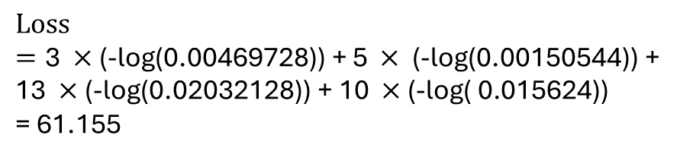
Unigram Language Model Tokenization
Vocabulary Pruning
We recompute the probabilities after removal of the token un.
Token | r | u | n | ru | b | g | bu | ug | f | fu | s | su
Freq | 3 | 31 | 26 | 3 | 5 | 5 | 5 | 5 | 13 | 13 | 10 | 10
Token | r | u | n | ru | b | g | bu | ug | f | fu | s | su
Freq | 0.0233 | 0.2403 | 0.2016 | 0.0233 | 0.0388 | 0.0388 | 0.0388 | 0.0388 | 0.1008 | 0.1008 | 0.0775 | 0.0775
Word | Freq | Split | Score
Run | 3 | ru, n | 0.00469728
Bug | 5 | bu, g | 0.00150544
Fun | 13 | fu, n | 0.02032128
Sun | 10 | su, n | 0.015624
$$\text{Loss}=\text{3 }×\text{(−}\text{log}\text{(0.00469728)) + 5 }×\text{ (−}\text{log}\text{(0.00150544)) + 13 }×\text{(−}\text{log}\text{(0.02032128)) + 10 }×\text{(−}\text{log}\text{( 0.015624)) } \\ \text{= 61.155}$$

Slide 51
Unigram Language Model Tokenization
Vocabulary Pruning
Next, we compute the impact of each token on the loss.
Assuming we are removing one token at each step, we can remove either bu or ug from the vocabulary at this iteration.
Token removed from vocabulary | Loss
ru | 63.0126
bu | 61.155
ug | 61.155
fu | 69.205
su | 67.347

Slide 52
References
IIT Delhi. (2024-25). Large language models (LLMs): Introduction and recent advances (ELL881/AIL821, Semester I).

